Slide 1
Report for Community Council
25th March – 18th April

Slide 2
Numbers:
We have worked with 210 young people
This equated to 420 learning hours
This happened at 26 different activities

Slide 3
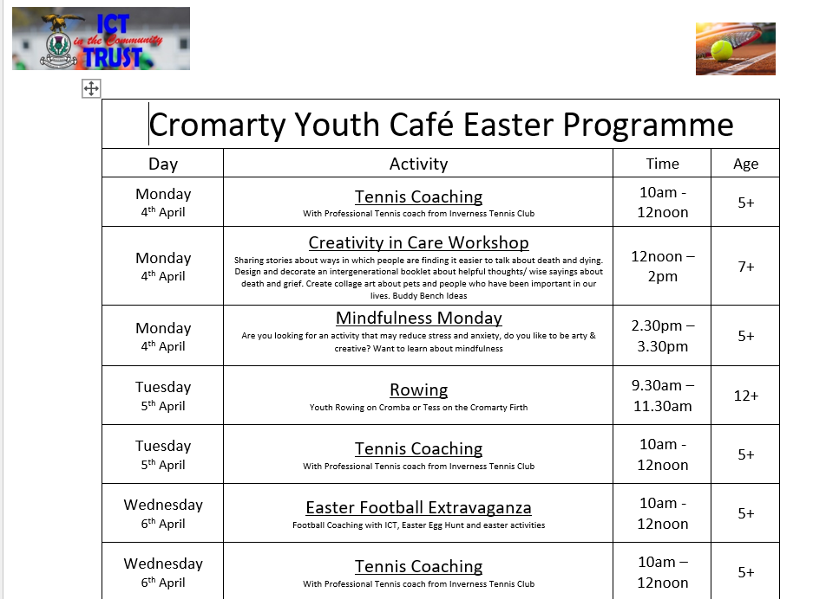
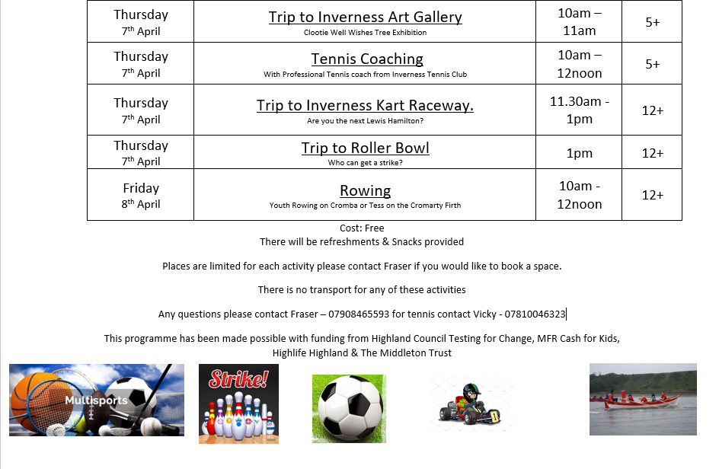

Slide 4
Easter Programme
With funding from MFR Cash for Kids, Highland Council Testing for Change & The Middleton Trust we were able to run a successful, fun filled easter programme.
The activities that were provided were done in consultation with young people, this was done as part of the testing for change application

Slide 5
Tennis Coaching
Tennis Coaching with Anne from Inverness Tennis Club,
Young people were focusing on improving thier racquet skills, serves, and moving around the court,
Anne provided lots of skills and drills and the young people really enjoyed the sessions and are looking forward to tennis coaching in the summer.

Slide 6
Creativity in Care Workshop
The creativity in care workshop
Looked at Sharing stories about ways in which people are finding it easier to talk about death and dying
Looked at ideas for designing the Reflecting bench
Designed and decorated an intergenerational booklet about helpful thoughts/ wise sayings about death and grief
•Created a collage art about pets and people who have been important in our lives. These could be designed into cards
The young people created a deluxe buffet for the session so all participants could sit and enjoy a lunch together and reminisce , they did baked and made homemade soup a variety of cakes were produced from some of the older folk's recipes things they liked when they grew up
Lots of skills were improved some very creative benches were made and some lovely art works

Slide 7
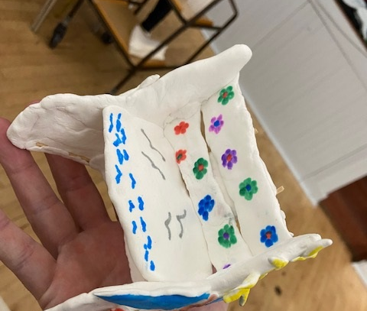
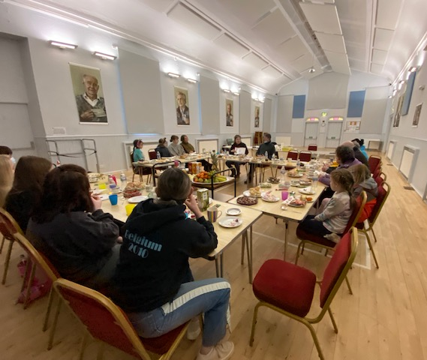
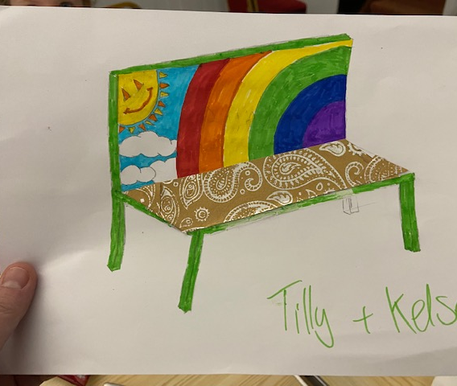
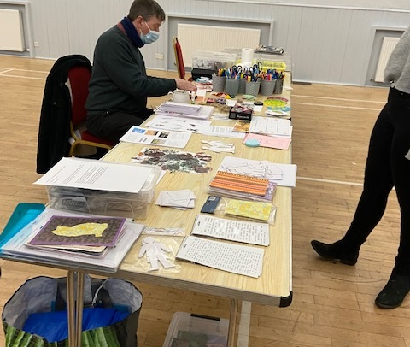
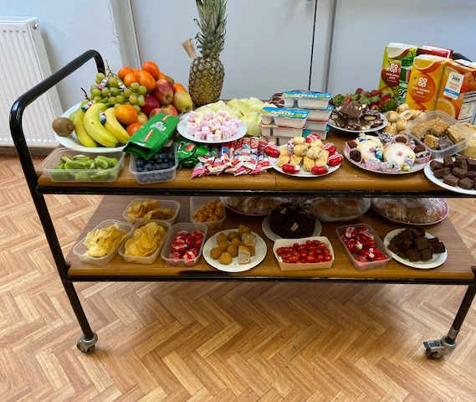
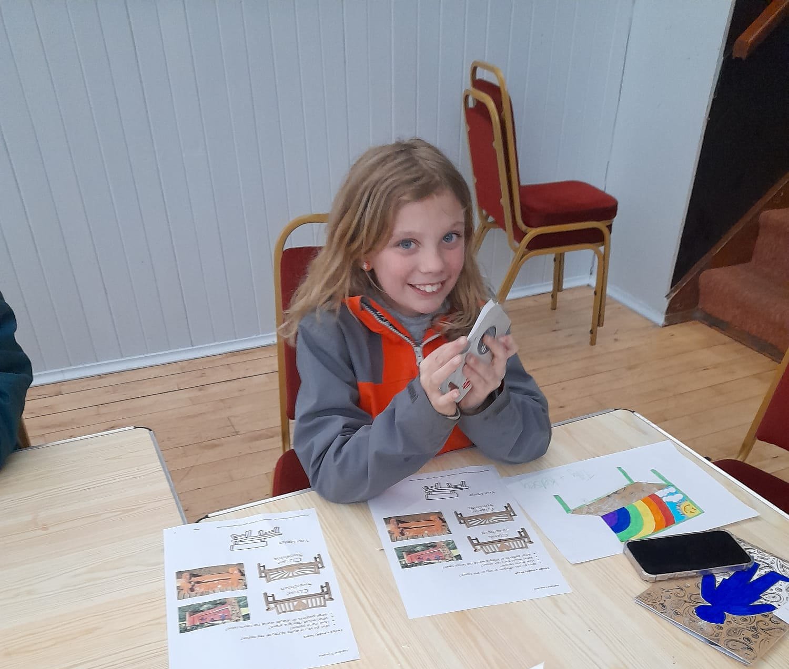

Slide 8
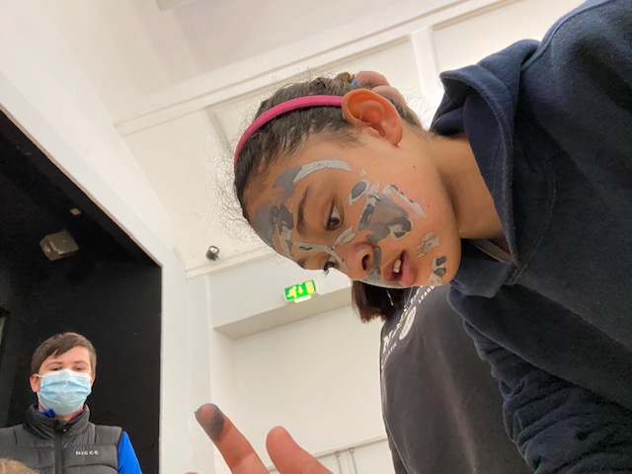
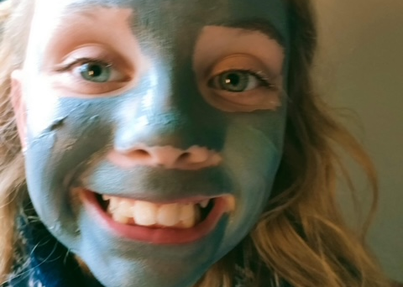
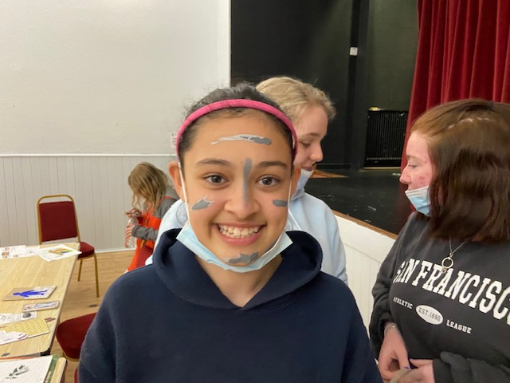
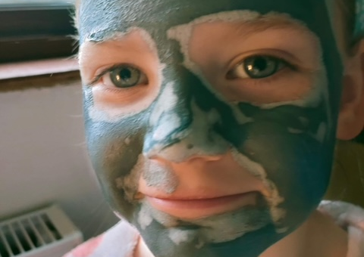
Pamper Session
Each Young person who attended the Creativity in Care Workshop were given a Deep Cleansing Face Mask to use at home to relax

Slide 9
Mindfulness Monday
Mindfulness Colouring in session with Naomi from Highlife Highland
Naomi brought along an art pack with a colouring book , notepad and colouring in pens and pencils each young person received a goody bag and a range of refreshments were provided to help the session have a relaxed atmosphere
One of the benefits to young people taking part in mindfulness colouring was that it helped to develop their creativity and improve their fine motor skills,
YP were shown techniques to help with relaxing, deep breathing and pausing just taking time for yourself and how to deal with stressful situations
Our younger people in the session enjoyed this activity a lot more than our older teenagers who took part but did not buy in to it so much.
One young person went home and showed her mum the book and said " when i am stressed i go to my room and use this book" she has been using the breathing techniques and is finding it helps to calm her down

Slide 10
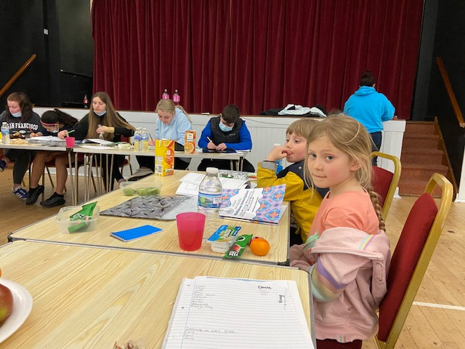
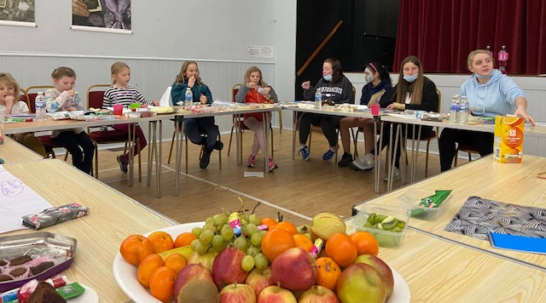
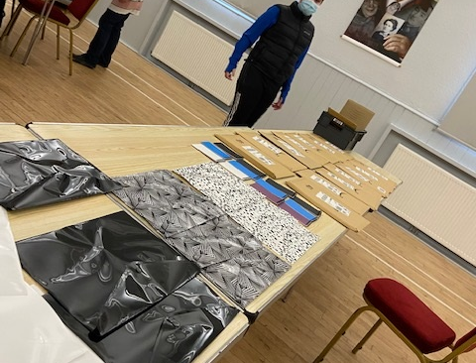

Slide 11
Easter Football Extravganza
For the arts and crafts part YP had the options to decorate a hardboiled egg, plastic eggs, plates, little bunnies and decorating cupcakes and little cake balls.
All the young people were decorating plates and were gluing, little chickens and bunnies to the plates. Once they decorated their plates they moved onto the hardboiled egg. Some of the eggs that they decorated were quite impressive.
There was a delicious buffet served to the YP including homemade deluxe waffles, Sandwiches , selections of fruits, crisps, popcorn, brownies, selection of home baking, juice and bottles of water.
The football session was focusing on passing and shooting games and some target practice, before moving to the matches to finish the session.
One of the games that they did was boys vs girls to kick the ball to hit other balls on the cones the first team to knock all the balls of the cones were the winners.

Slide 12
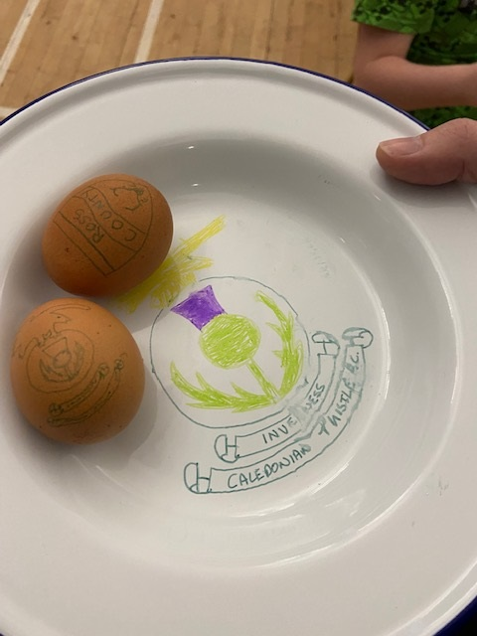
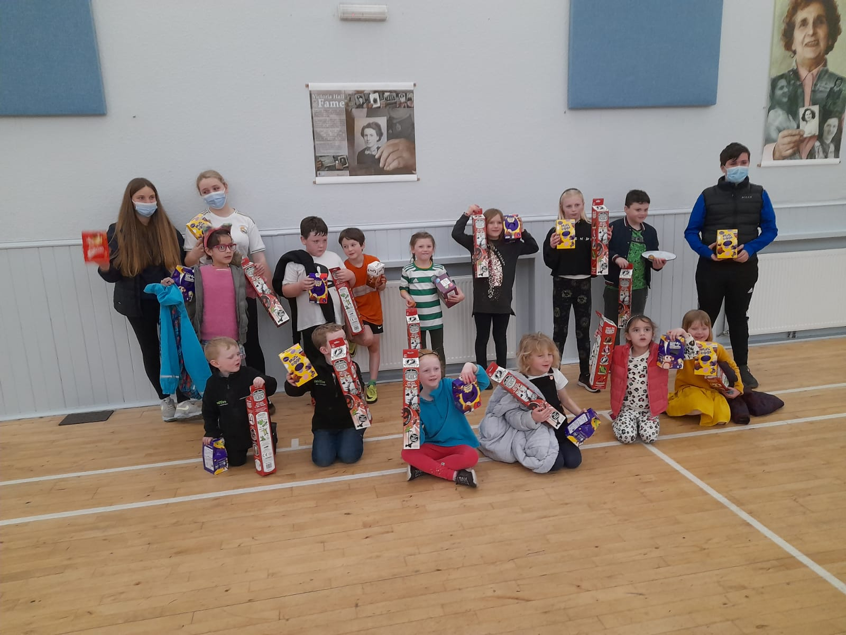

Slide 13
Trip to Inverness Art Gallery
We were all invited to Highlife Highland’s Inverness Art Gallery to support Allison to create the Well Wishes Exhibition ( project mentioned in pervious reports)
When arriving at the art gallery Allison explained to the young people about the exhibitions at the front door,
There was a display that was created from the Highland Hospice with Sunflowers
There was a display from the Inverness Women's Aid, this was created during Lock Down when vulnerable families were supported at the refuge were isolated in their room. and no one knew about each other.no one knew each other. The Art pieces were about the feeling when arriving at the refuge where they started to where they are when they leave
Allison explained to the YP about the museum and told the young people they are more than welcome to come back to the gallery anytime

Slide 14
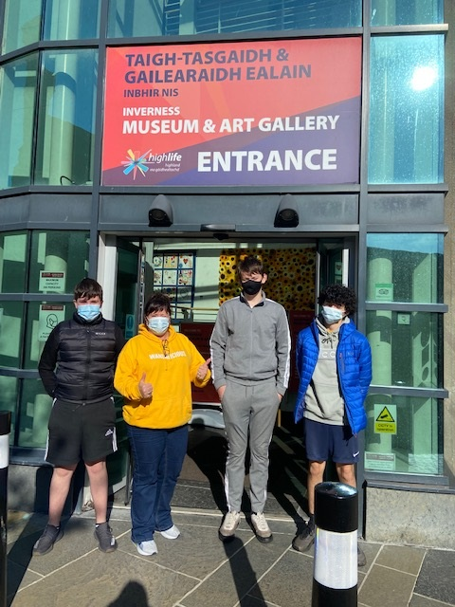
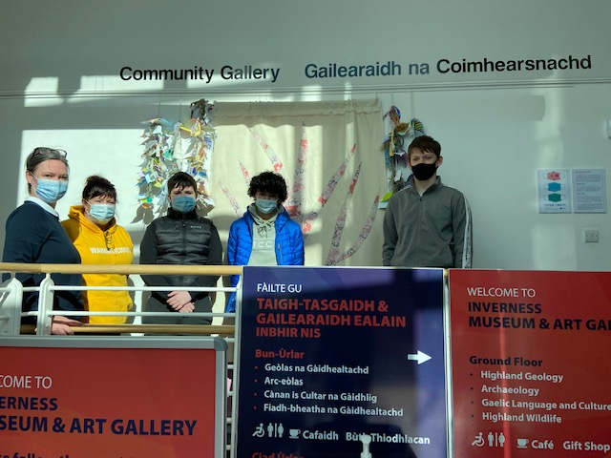
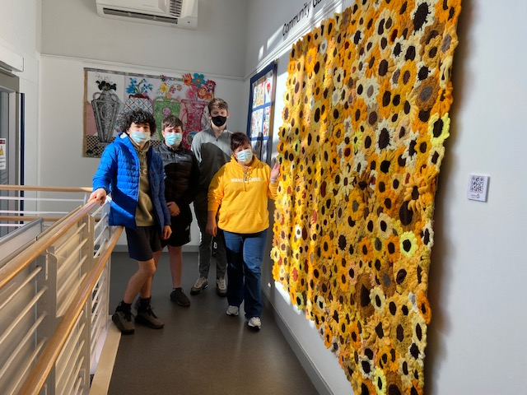

Slide 15
Trip to Inverness Kart Raceway
Trip to Inverness Go Karting track with young leaders,
The group were learning how to use the go karts learning about safety and how to have fun.
They enjoyed races and were very competitive one of our young girls is the Black Isle Champion Karter so this provided an element of fun and challenge
She came first on the day followed by Cody and Teagan who at 17 are now learning to drive to had this edge then the rest lots of skills were gained at the session most young people had never been at karting before
All the young people asked if they could come again in the summer.

Slide 16
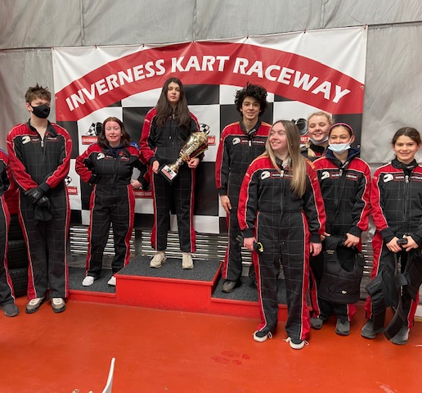
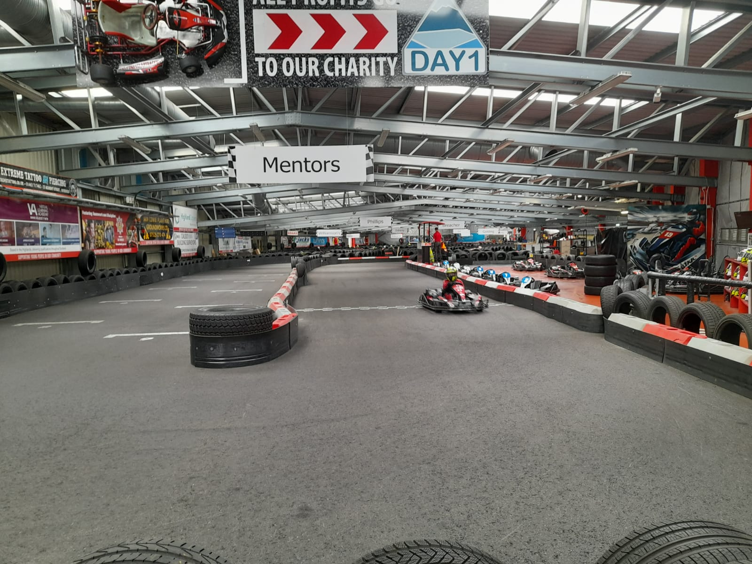
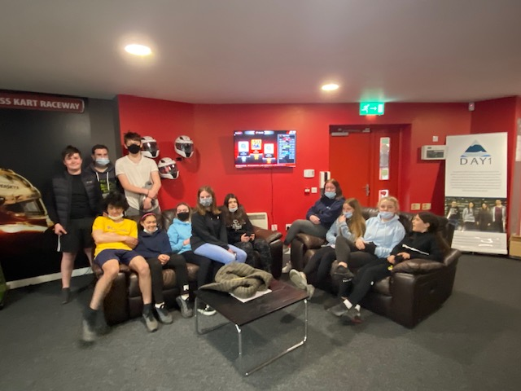

Slide 17
Trip to Roller Bowl
The YP split themselves into 2 teams,
There was lots of negotiations as to who was in each team.
Each game was very competitive
The YP really enjoyed the day and asked if they could come back in the summer holiday

Slide 18
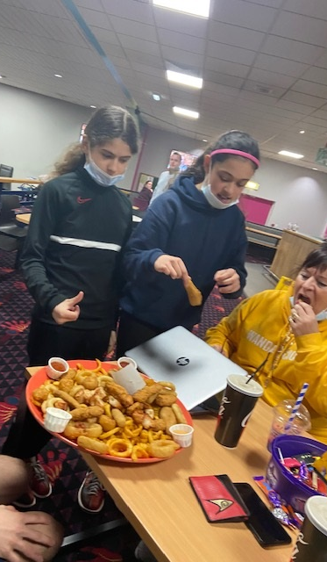
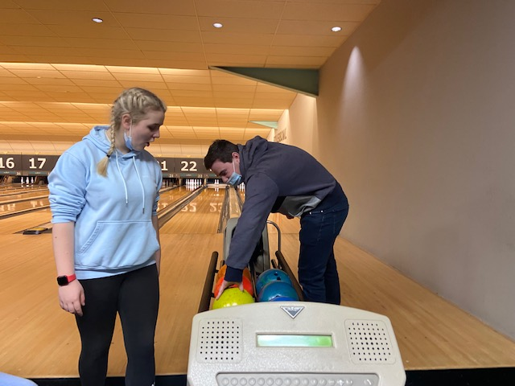
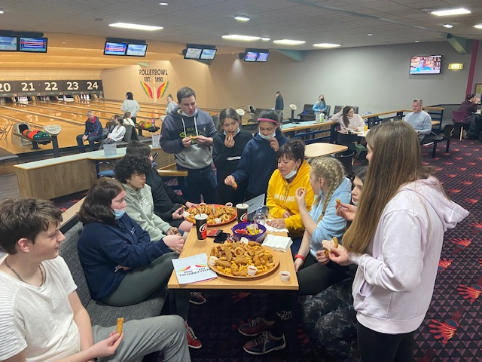

Slide 19
Trip to Infinity Trampoline Park
The session started with YP filling in their registration forms at the trampolining park.
Once forms were filled in YP were asked to watch the safety video, the video needed to be watched before they were able to go on the trampolines,
Once on the trampolines the young people went to the dodgeball court.
The YP were split into teams and the rules of dodgeball were followed
Lots of red happy faces at the end of the session

Slide 20
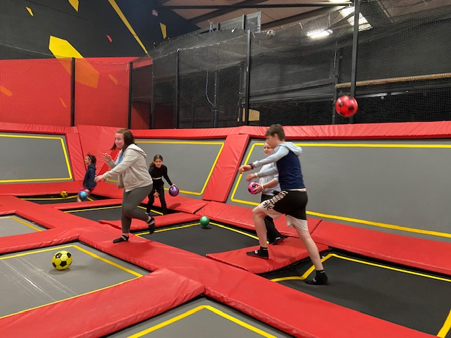
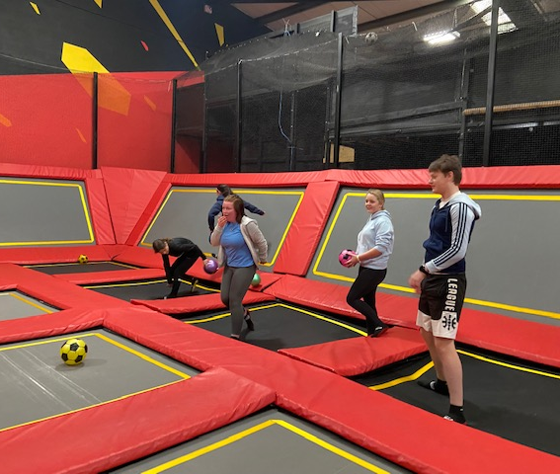
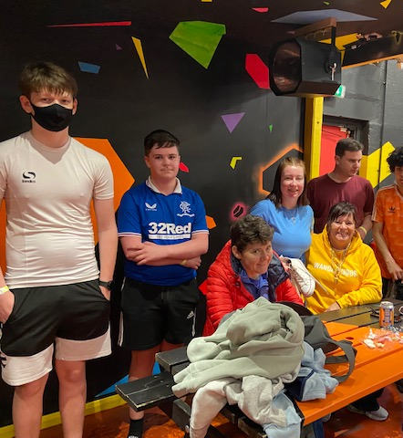
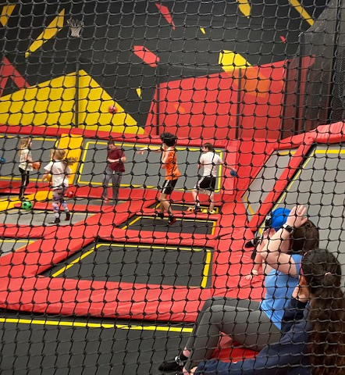

Slide 21
Multi Sports
Every Monday night, this is led by Young leaders
The young leaders are working toward Their Choose Lead Level 4 with High Life Highland
Young leaders plan , deliver and then review the session
The plan is always delivered around what young people want,
Each week young people are playing new games and are working on different skills, such as team work, throwing and catching, & communication skills

Slide 22
Well Being Bags
YP created well being food packs for older members of the community.
Some of the items were donated from Cromarty Youth Cafe and or from the Pallet of Food from CFINE
Through conversations with YDO and YP the older people were identified
All bags were dropped on the doorsteps of older people, young people knocked and stood back greeted the older people and passed the time of day with them .
When doing the deliveries all COVID Guidelines were maintained. Hands santised before and after touching doors and gates

Slide 23
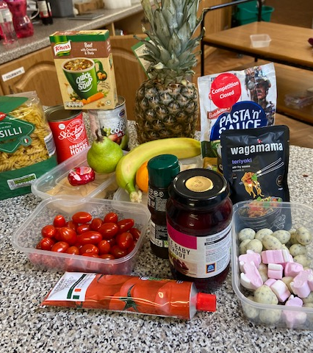
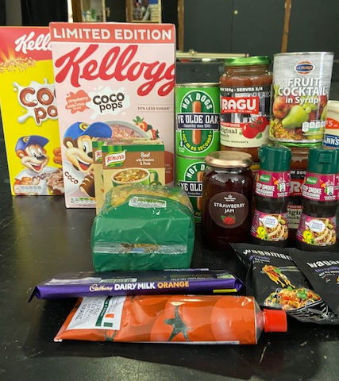

Slide 24
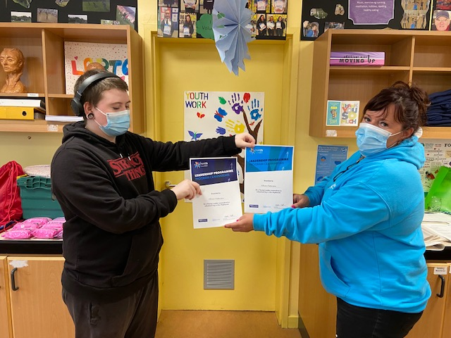
HighLife Highland Leadership
Huge Well Done to Ethan Paterson for gaining his Navy and Purple Leadership Hoodie, for all his hard work in the Youth Work Classroom,
Leading at the Equalities & Diversity Group

Slide 25
Cookwell / Bakewell
Every week Young people take part in Cooking / Baking creating a range of different dishes, sweet and savoury.
The young people who attend learn new skills, Knife skills, learning about different food and how to cook different foods

Slide 26
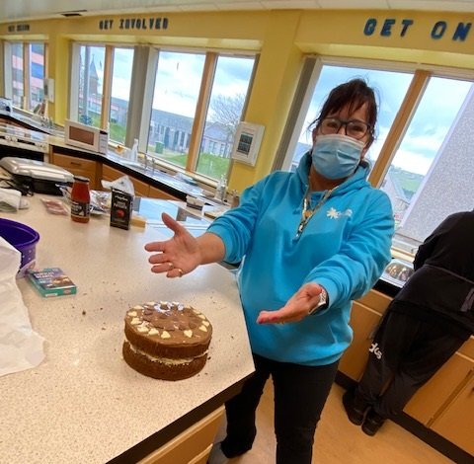
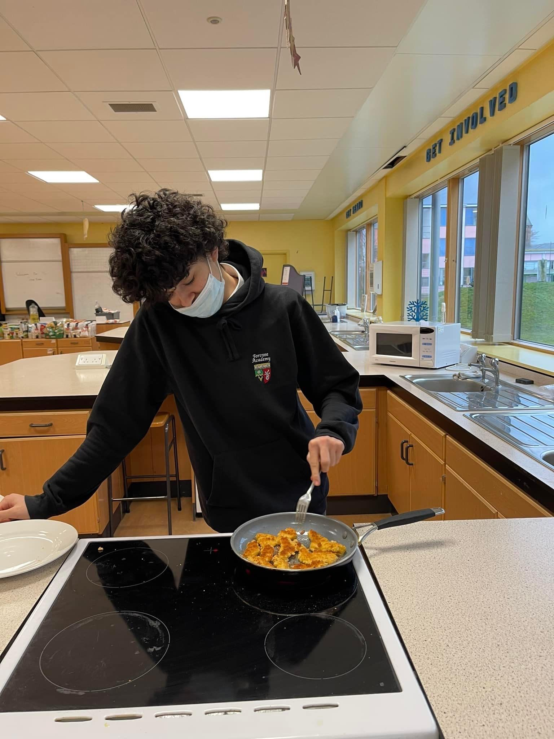
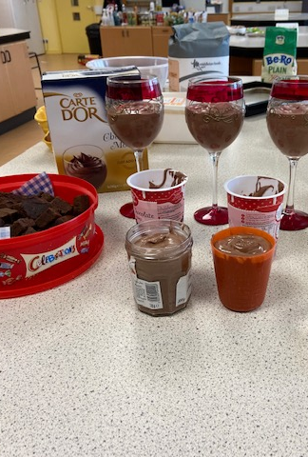
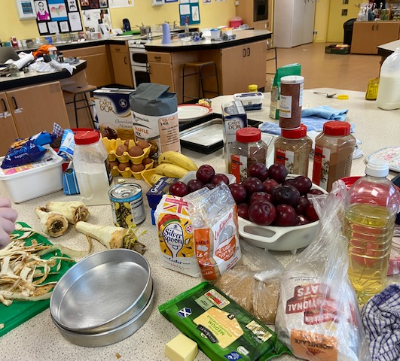

Slide 27
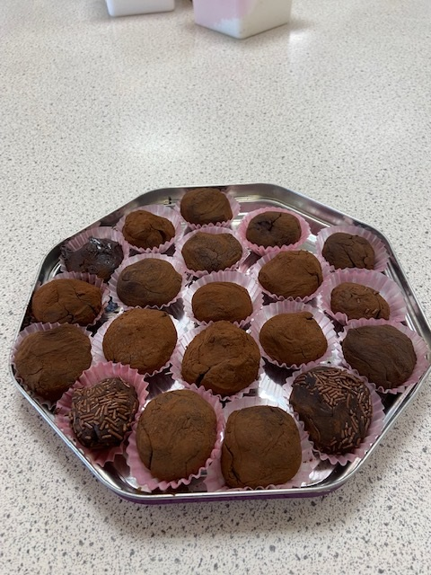
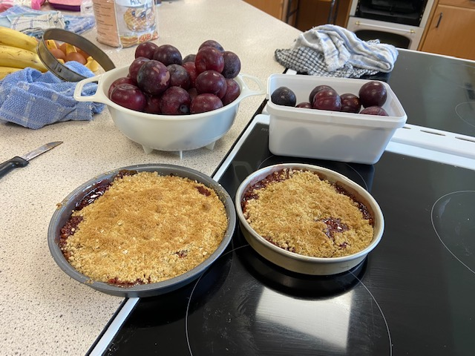

Slide 28
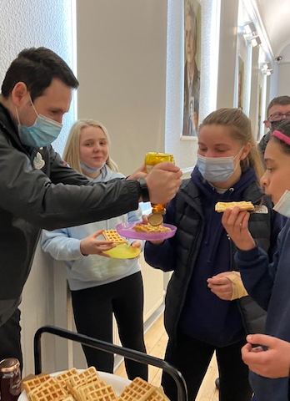
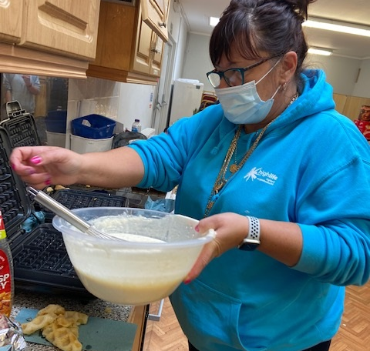
Wanda’s Wednesday Waffle Mainia
With funding from Youth Scotland Rural Action fund we purchased a Waffle Maker.
The young people enjoy making fresh Belgian waffles with a range of toppings

Slide 29
Thank you for Reading
If you would like anymore information please get in contact.
Also keep an eye on our facebook page – Cromarty Youth Café to keep up to date with what we are up to
☺

